Slide 1
Exploratory Data Analysis of Airbnb NYC : Unveiling Trends and Insights
Group 2: Sireesha Gangarapu Sai Swaroop Manne Kavya Sri Myakala Vinay Suhaas Gandi

Slide 2
Our project focuses on leveraging Python for data analysis and visualization to explore the 2023 NYC Airbnb dataset. The analysis aims to uncover trends in property availability, pricing, and performance metrics across various neighborhoods. Using Python libraries such as Pandas, NumPy, Matplotlib, and Seaborn, the project performs exploratory data analysis (EDA) to identify patterns in hosting behaviors and guest preferences.
Key insights include:
Variations in pricing and room availability across boroughs.
The impact of minimum night requirements and host activity on bookings.
Sparse regulatory data, emphasizing the need for improved compliance tracking.
This project demonstrates Python's capabilities in handling real-world datasets and provides actionable insights for stakeholders in the short-term rental market.
Abstract

Slide 3
Introduction
Project Objective: To analyze the NYC Airbnb 2023 dataset using Python, uncovering insights into property trends, pricing strategies, and host behaviors.
Scope of Analysis:
Understand geographical distribution of listings across NYC boroughs.
Identify trends in pricing, availability, and review activity.
Highlight gaps in regulatory compliance based on licensing data.
Tools and Technologies:
Python libraries: Pandas, NumPy, Matplotlib, Seaborn.
Dataset: NYC Airbnb 2023.
Significance: This project showcases Python's utility in data-driven decision-making and its application to real-world datasets for market insights.

Slide 4

Dataset Overview
id: Unique identifier for each listing.
name: The title of the Airbnb listing.
host_id: Unique identifier for the host.
host_name: Name of the host.
neighbourhood_group: The borough where the listing is located (e.g., Manhattan, Brooklyn).
neighbourhood: Specific neighborhood within the borough.
latitude & longitude: Geographic coordinates of the listing.
room_type: Type of accommodation (e.g., Entire home/apt, Private room).
price: Cost per night (in USD).
minimum_nights: Minimum nights required for booking.
number_of_reviews: Total number of reviews for the listing.
reviews_per_month: Average reviews per month.
last_review: Date of the most recent review.
calculated_host_listings_count: Number of listings managed by the same host.
availability_365: Number of days the listing is available in a year.
license: Licensing information for compliance .

Slide 5
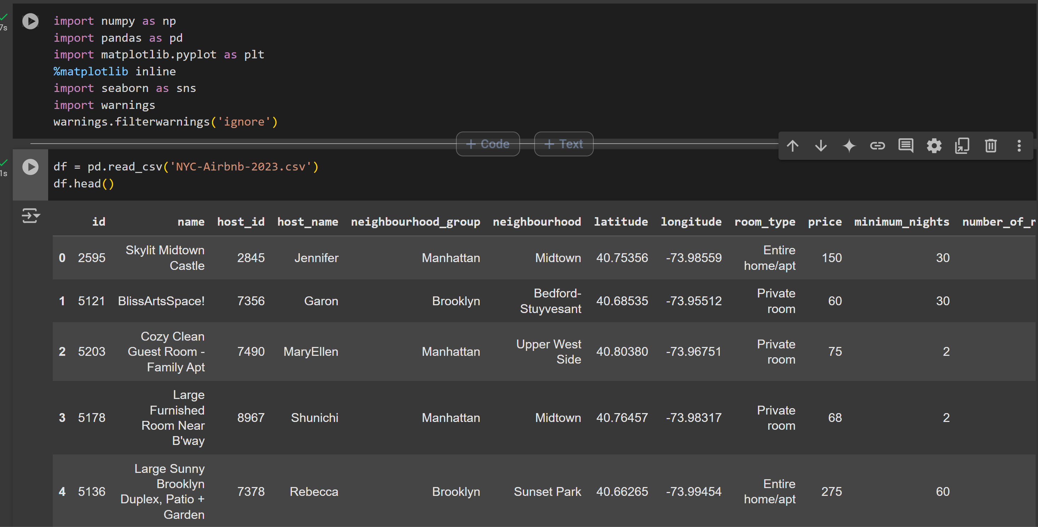

Slide 6
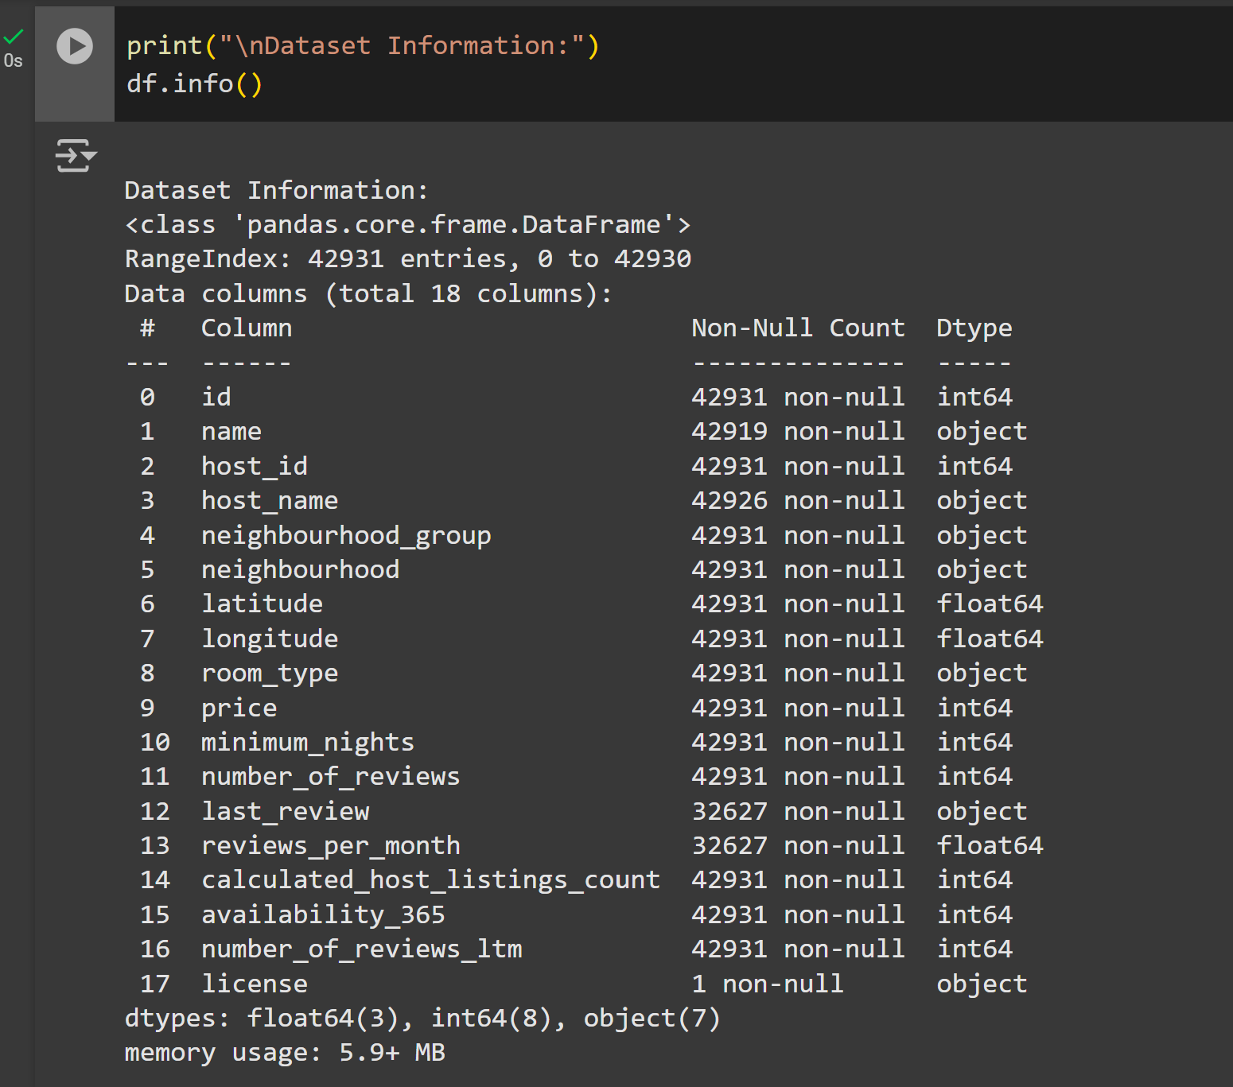
Data Preprocessing
As with every dataset, several preprocessing steps needed to be mitigated to guarantee the applicability and soundness of the data.

Slide 7
Cleaning Missing Values
The dataset was inspected for missing data in critical columns such as name, reviews_per_month, and license.
Missing values in non-essential columns (e.g., last_review) were excluded or imputed where necessary to ensure the dataset remains contextually and statistically valid.
Formatting Adjustments
Leading and trailing whitespaces were removed from text fields to standardize formatting.
Date columns like last_review were converted into a standardized DateTime format to facilitate temporal analysis. Rows with invalid or missing dates were excluded.

Slide 8

Methodology
The EDA process was conducted as follows:
1. Data Cleaning: Removing duplicate records and dealing with missing values.
2. Exploratory Analysis: Using summary statistics to pre-analyze data.
3. Visualization: Using Matplotlib and Seaborn libraries to plot the findings clearly.
4. Statistical Analysis: Analyze correlation tests and a trend analysis to develop insights into the data.

Slide 9
Results and Discussion
Distribution of Airbnb Prices:
The distribution of Airbnb prices plot shows the frequency of listings at different price points, with the smooth line indicating the price density. Most listings tend to cluster around lower to mid-range prices, with fewer high-priced properties. The distribution often shows a right skew, indicating a small number of luxury listings.
This analysis helps understand common pricing trends, identify outliers, and assist hosts in setting competitive prices, while also providing insights for market analysis.

Slide 10
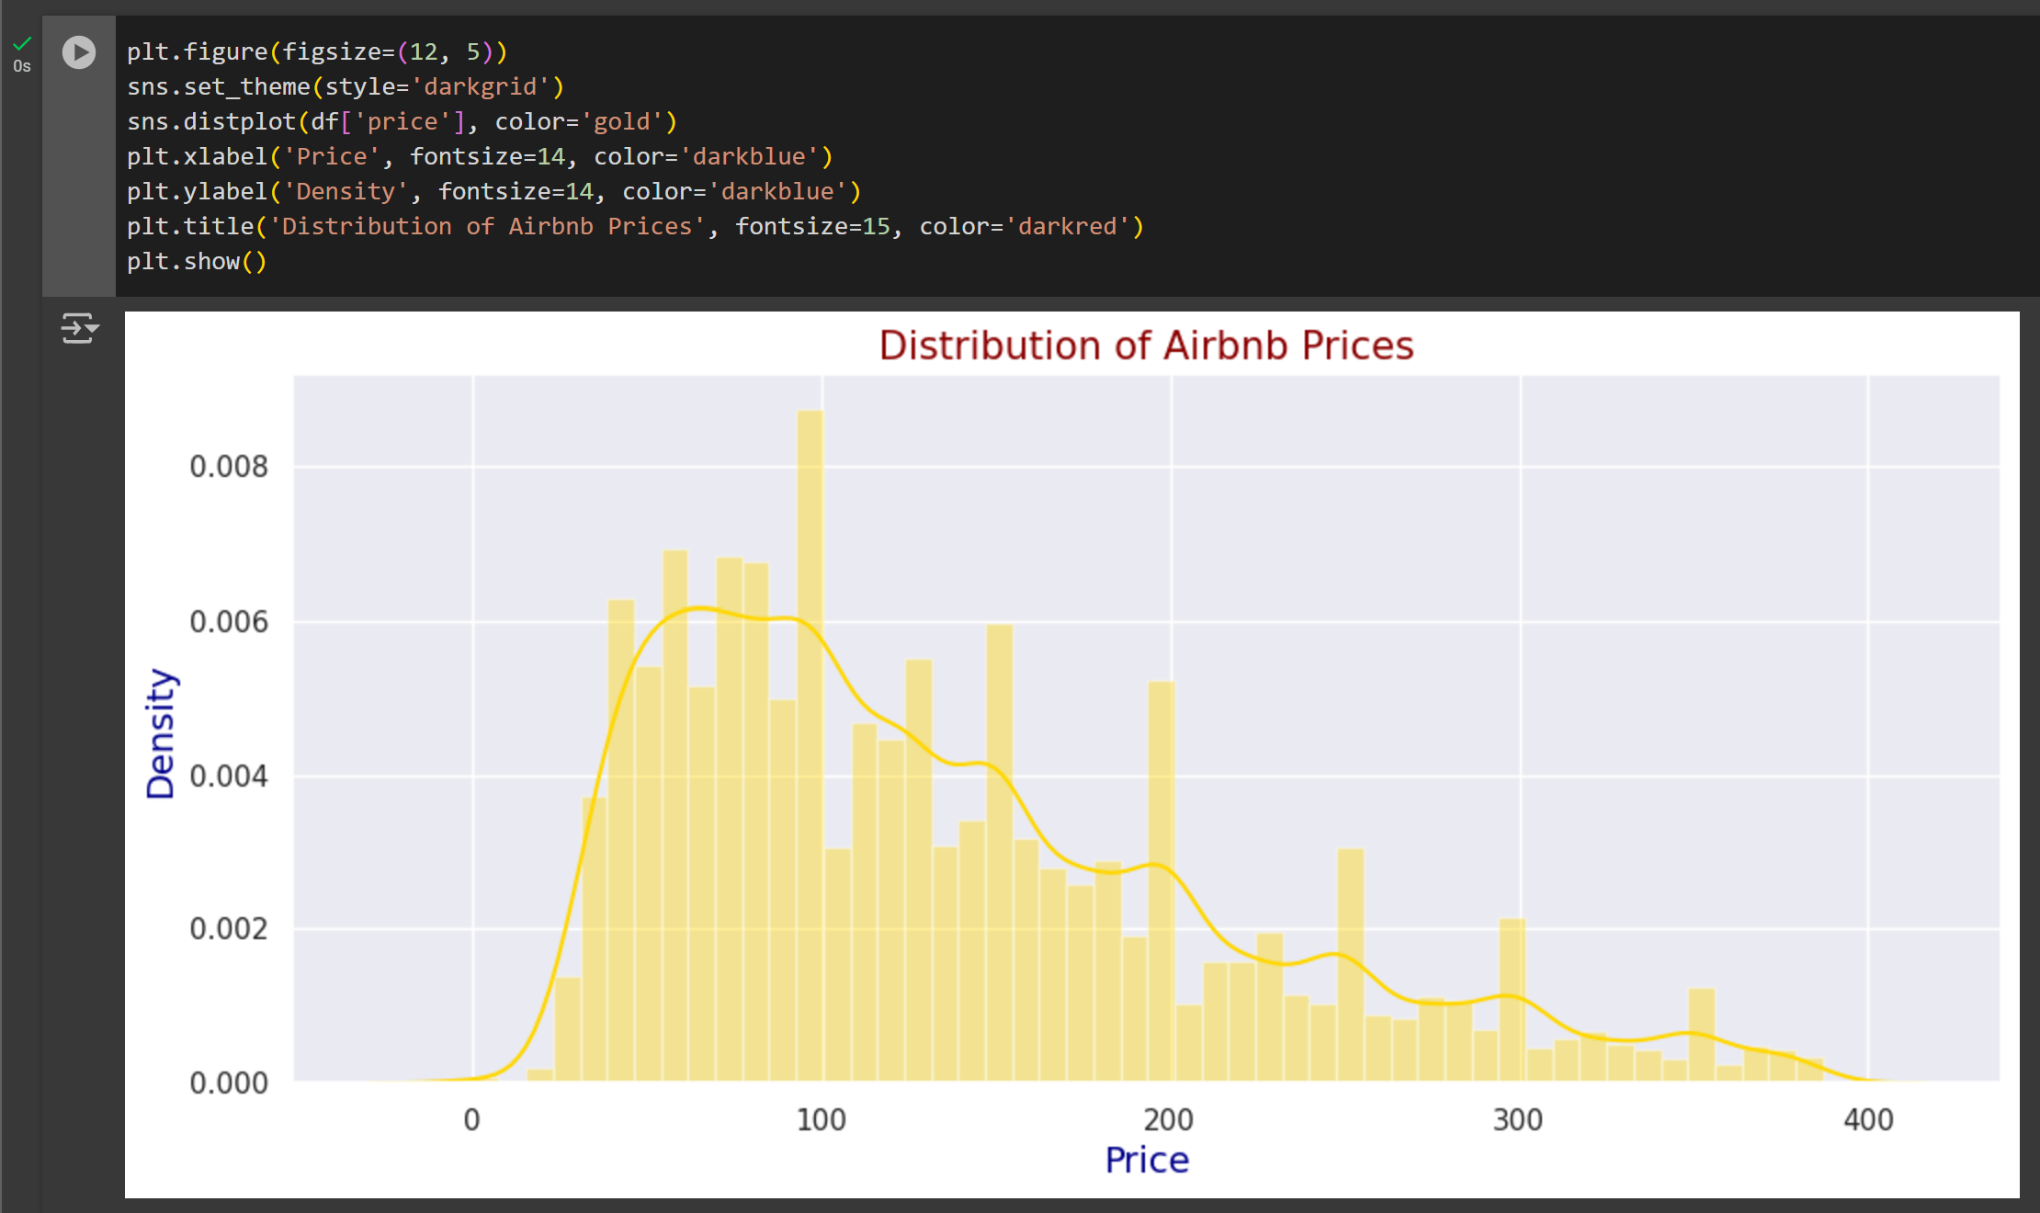

Slide 11

The Neighborhood Group Listing Counts
The Neighborhood Group Listing Counts plot shows the distribution of Airbnb listings across different neighborhoods in New York City. It highlights which areas have the most listings, with more popular areas showing higher counts.
This helps hosts and analysts identify high-demand neighborhoods and potential areas for investment or expansion. The plot offers insights into the concentration of Airbnb properties across the city.

Slide 12
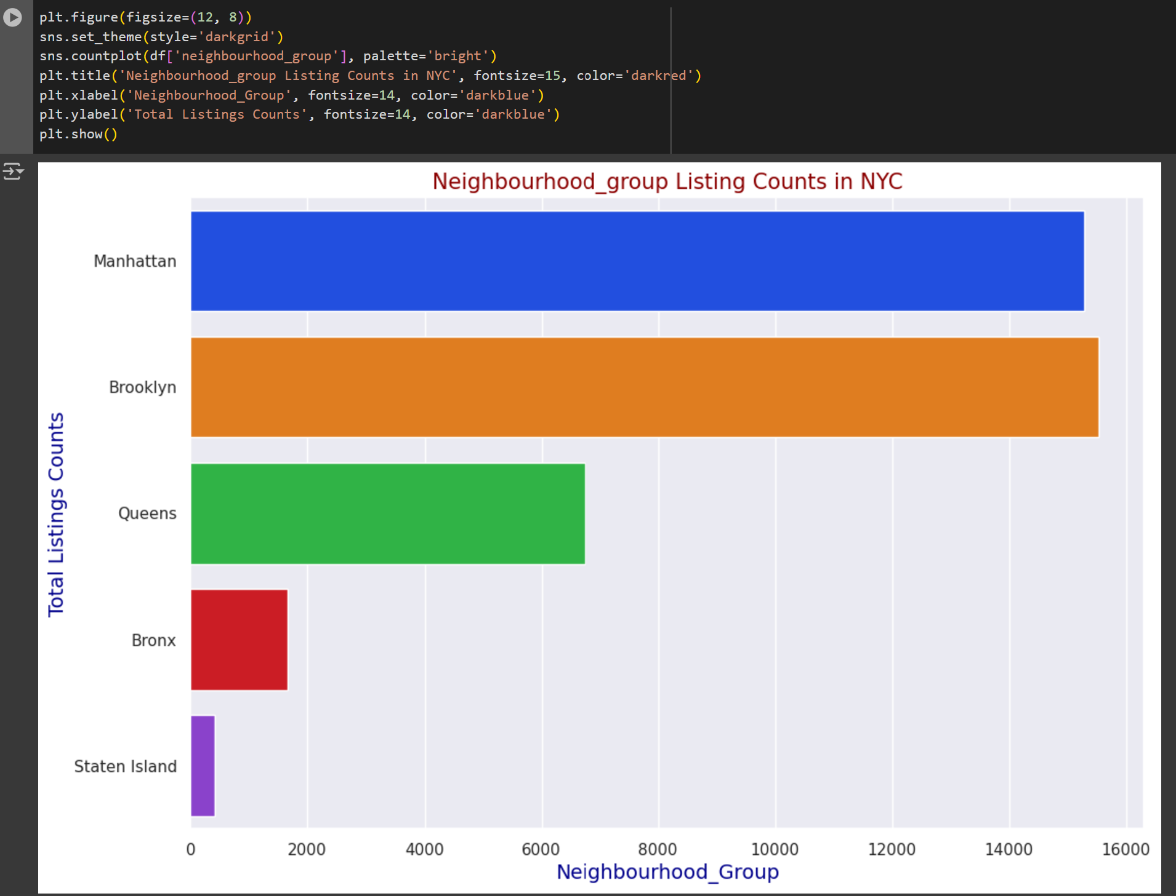

Slide 13

The Price Distribution by Neighborhood Group
The Price Distribution by Neighborhood Group plot shows how Airbnb prices are distributed across different neighborhoods in New York City. The width of each "violin" represents the density of listings at specific price points, with wider areas indicating more listings at those prices.
This plot helps to visualize the price range and variability within each neighborhood, highlighting areas with higher or lower price variability. It also reveals outliers, such as luxury listings in more expensive neighborhoods. This information is useful for hosts to adjust pricing and for analysts to identify pricing trends across the city.

Slide 14
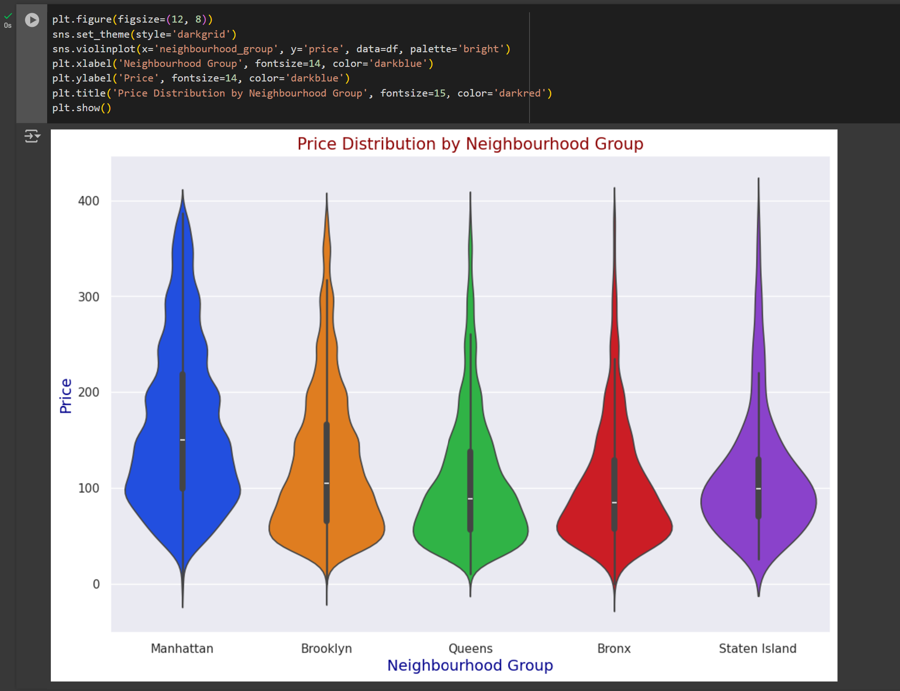

Slide 15
Average Price by Neighborhood Group
The Average Price by Neighborhood Group plot shows the average price of Airbnb listings in different neighborhoods across New York City. It provides a clear comparison of which areas are more affordable and which are more expensive.
This information can help hosts set competitive prices based on the neighborhood, and it also helps analysts understand pricing trends in different parts of the city. The plot offers insights into how location influences the cost of Airbnb listings in NYC.

Slide 16
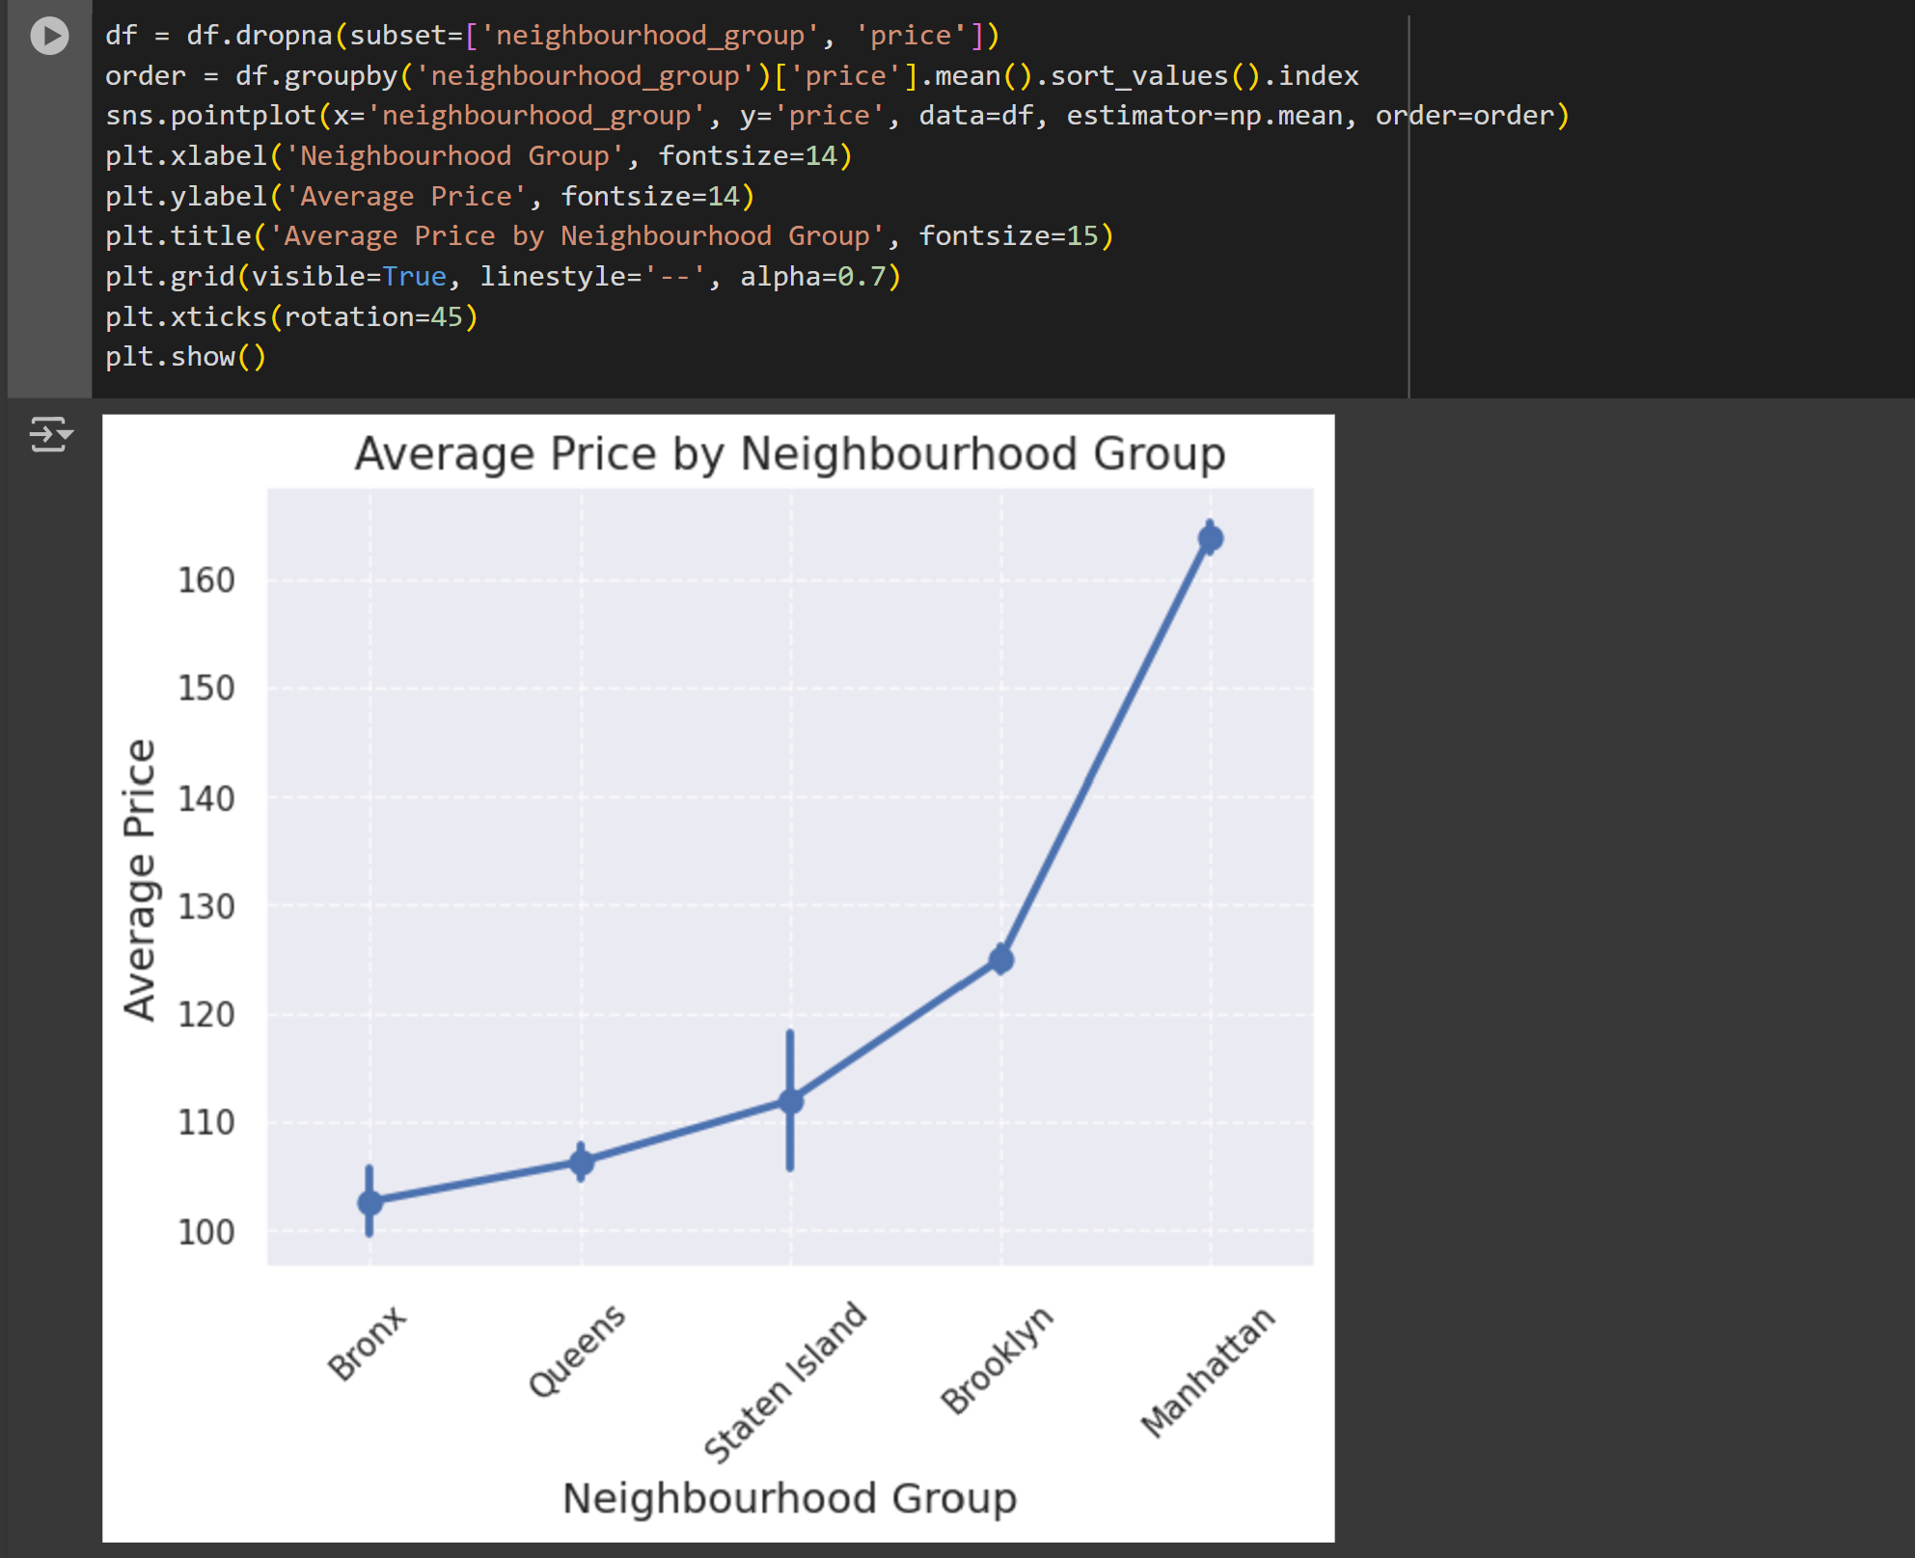

Slide 17

The Listings by Top Neighborhoods
in NYC
The Listings by Top Neighborhoods in NYC plot displays the 10 neighborhoods with the highest number of Airbnb listings. It visually compares the concentration of listings across different neighborhoods, highlighting the most popular areas in the city.
This information helps hosts decide whether to list in high-demand neighborhoods or target less competitive areas. For analysts, it provides insights into market trends, identifying areas with strong rental activity, which can influence pricing strategies and investment decisions.

Slide 18
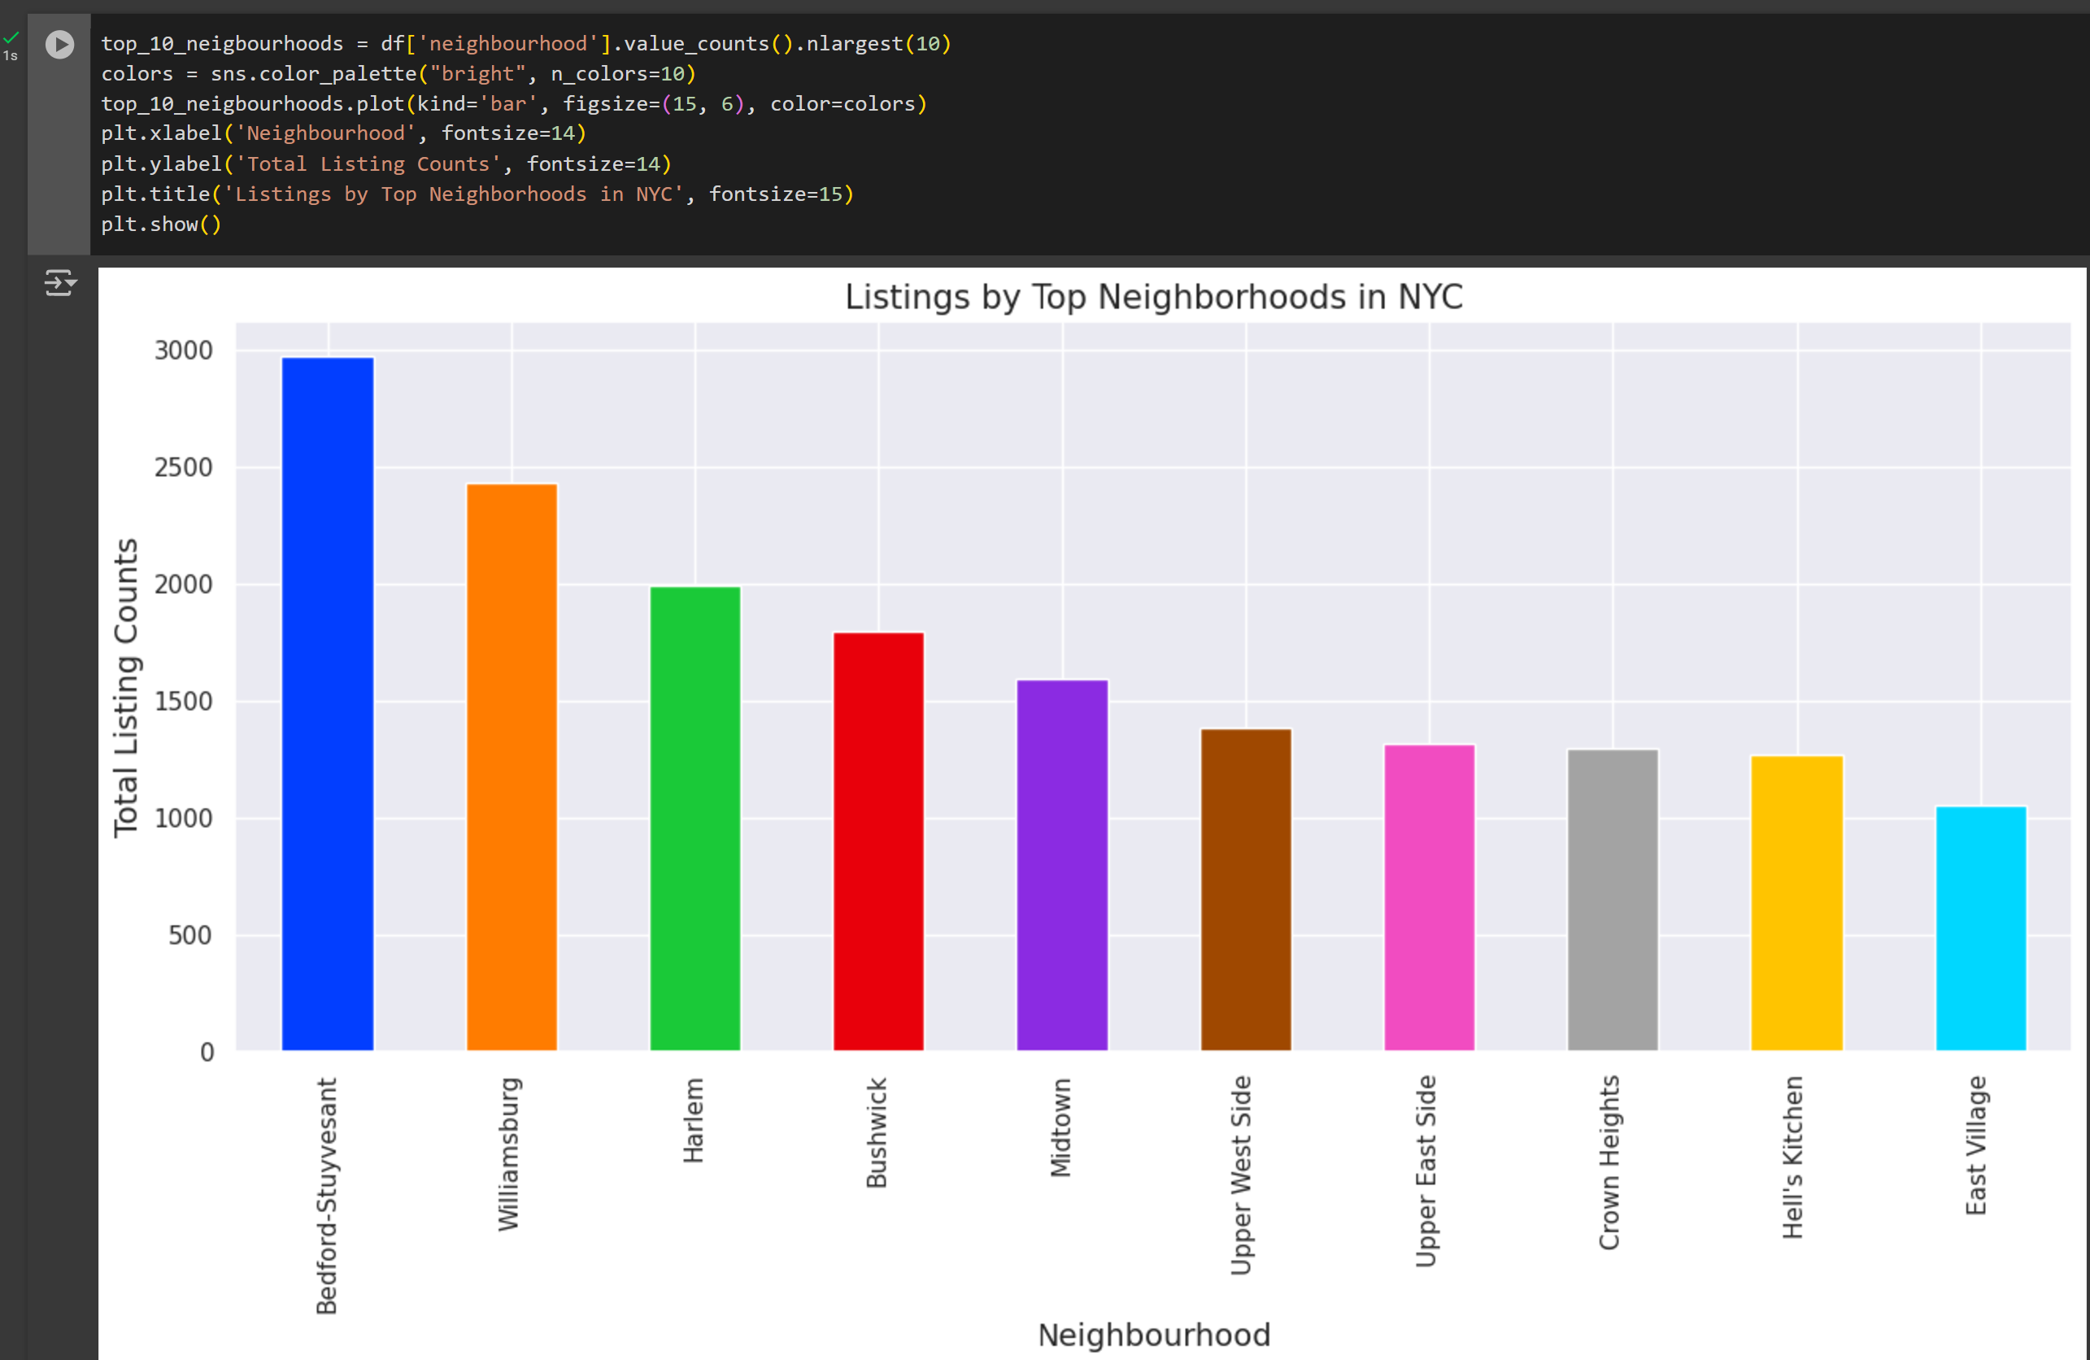

Slide 19

The Top 10 Hosts by Number of Listings in NYC
The Top 10 Hosts by Number of Listings in NYC plot displays the 10 hosts with the highest number of Airbnb listings in New York City. It shows the concentration of listings among the most active hosts, with the height of each bar indicating the total number of properties they manage.
This information helps potential hosts understand the competitive landscape and the level of market dominance by certain hosts. For analysts, it provides insights into market concentration and the scale of operations in the NYC Airbnb market.

Slide 20
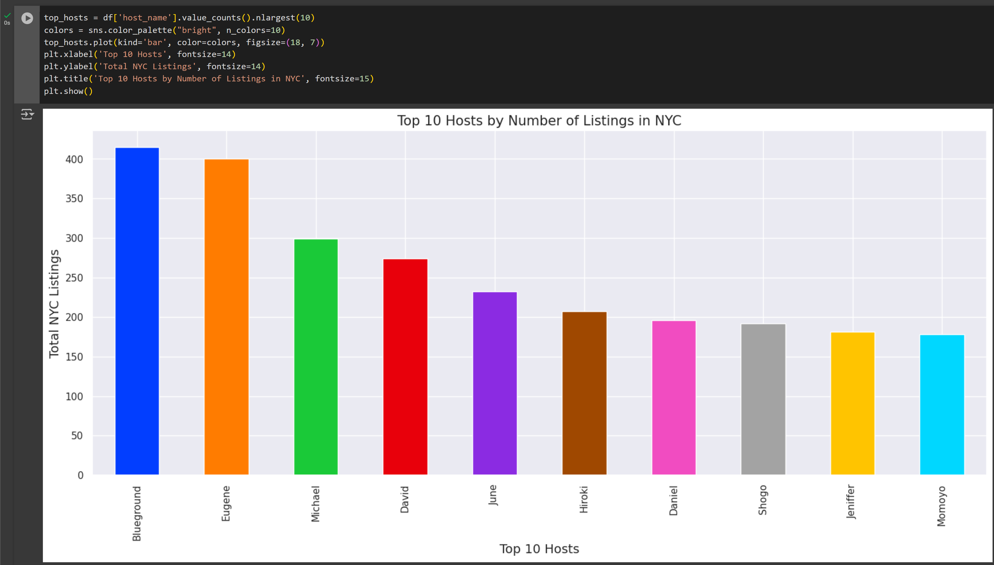

Slide 21

The Number of Active Hosts per Location
The Number of Active Hosts per Location plot shows the total number of active Airbnb hosts in each neighborhood group of New York City. The x-axis represents different neighborhood groups, while the y-axis shows how many hosts are active in each area.
This plot helps identify which neighborhoods have more hosts and which have fewer, giving insights into market competition. Hosts can use this information to decide where to list their properties, and analysts can assess market saturation to understand trends and opportunities in different parts of the city.

Slide 22
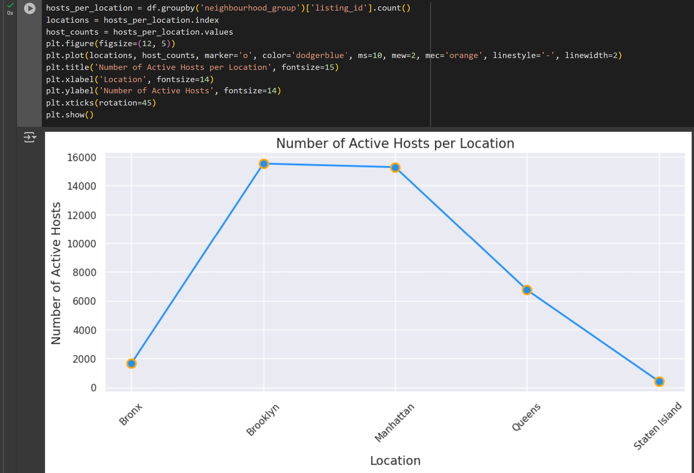

Slide 23

Average Airbnb Price by Neighborhoods in NYC
Average Airbnb Price by Neighborhoods in NYC
This analysis calculates the average price of Airbnb listings in each neighborhood across New York City. It then identifies the top 10 neighborhoods with the lowest average prices. The data is visualized using a scatter plot, where each point represents a neighborhood, and the color indicates the average price. The plot helps to easily see price variations across the city, highlighting areas with lower average prices and providing insights into pricing trends across different neighborhoods. This can be useful for hosts and analysts to understand market pricing.

Slide 24
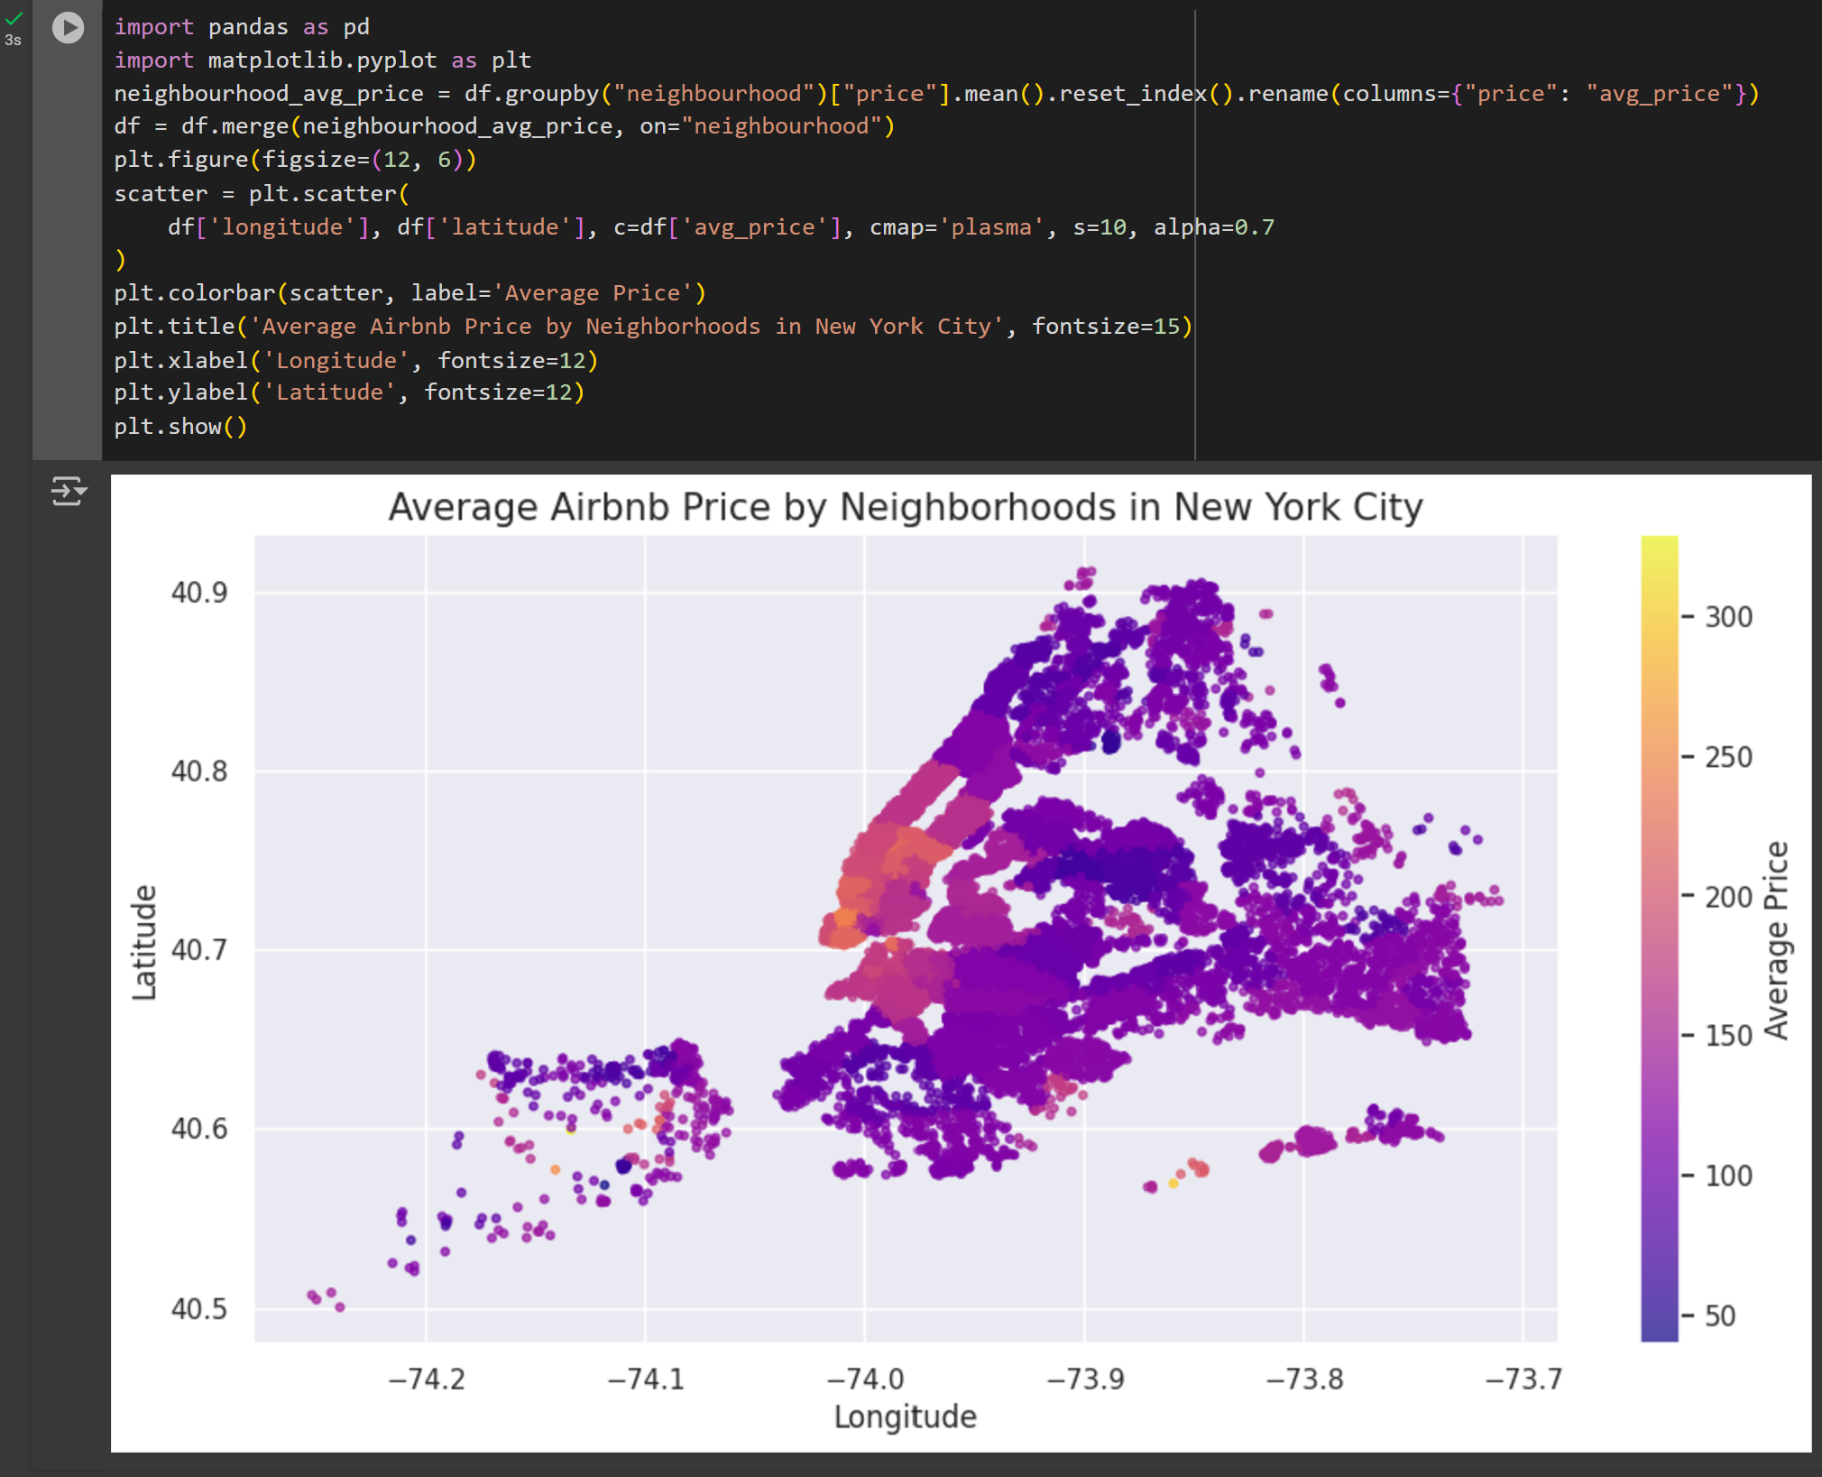

Slide 25

Top 10 Neighborhoods by Average Price
Top 10 Neighborhoods by Average PriceThis bar chart displays the top 10 neighborhoods in New York City with the highest average Airbnb prices. The x-axis represents the neighborhood names, and the y-axis shows the average price of listings in each neighborhood. The chart helps identify which neighborhoods have the highest rental prices, providing useful insights for hosts and potential investors.
By comparing the bars, you can easily see the price differences between the top neighborhoods in NYC. This information is valuable for setting competitive prices or evaluating areas with higher or lower demand.

Slide 26
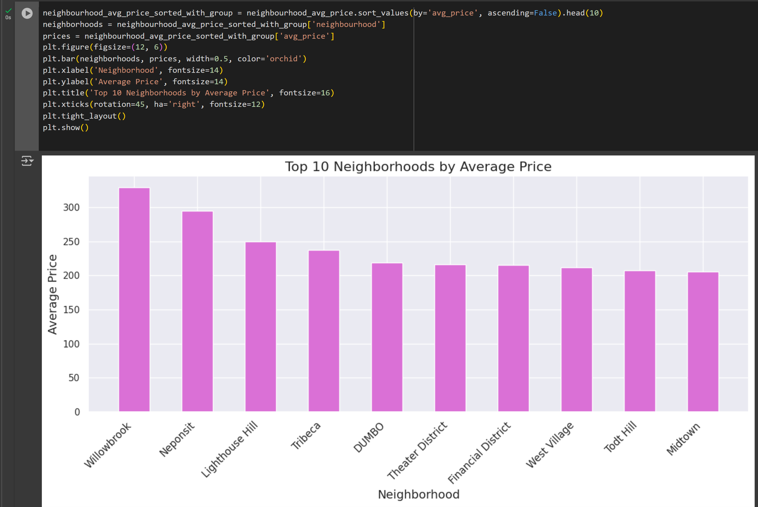

Slide 27

Room Type Distribution in NYC
Room Type Distribution in NYC Airbnb ListingsThis analysis examines the distribution of room types in Airbnb listings across New York City. It first calculates the total count of each room type, then visualizes the data with a pie chart.
The chart shows the percentage of listings for each room type, making it easy to identify the most popular types. This information helps hosts understand which room types are more common in the market, while analysts can use it to gauge consumer preferences and trends in the Airbnb market.

Slide 28
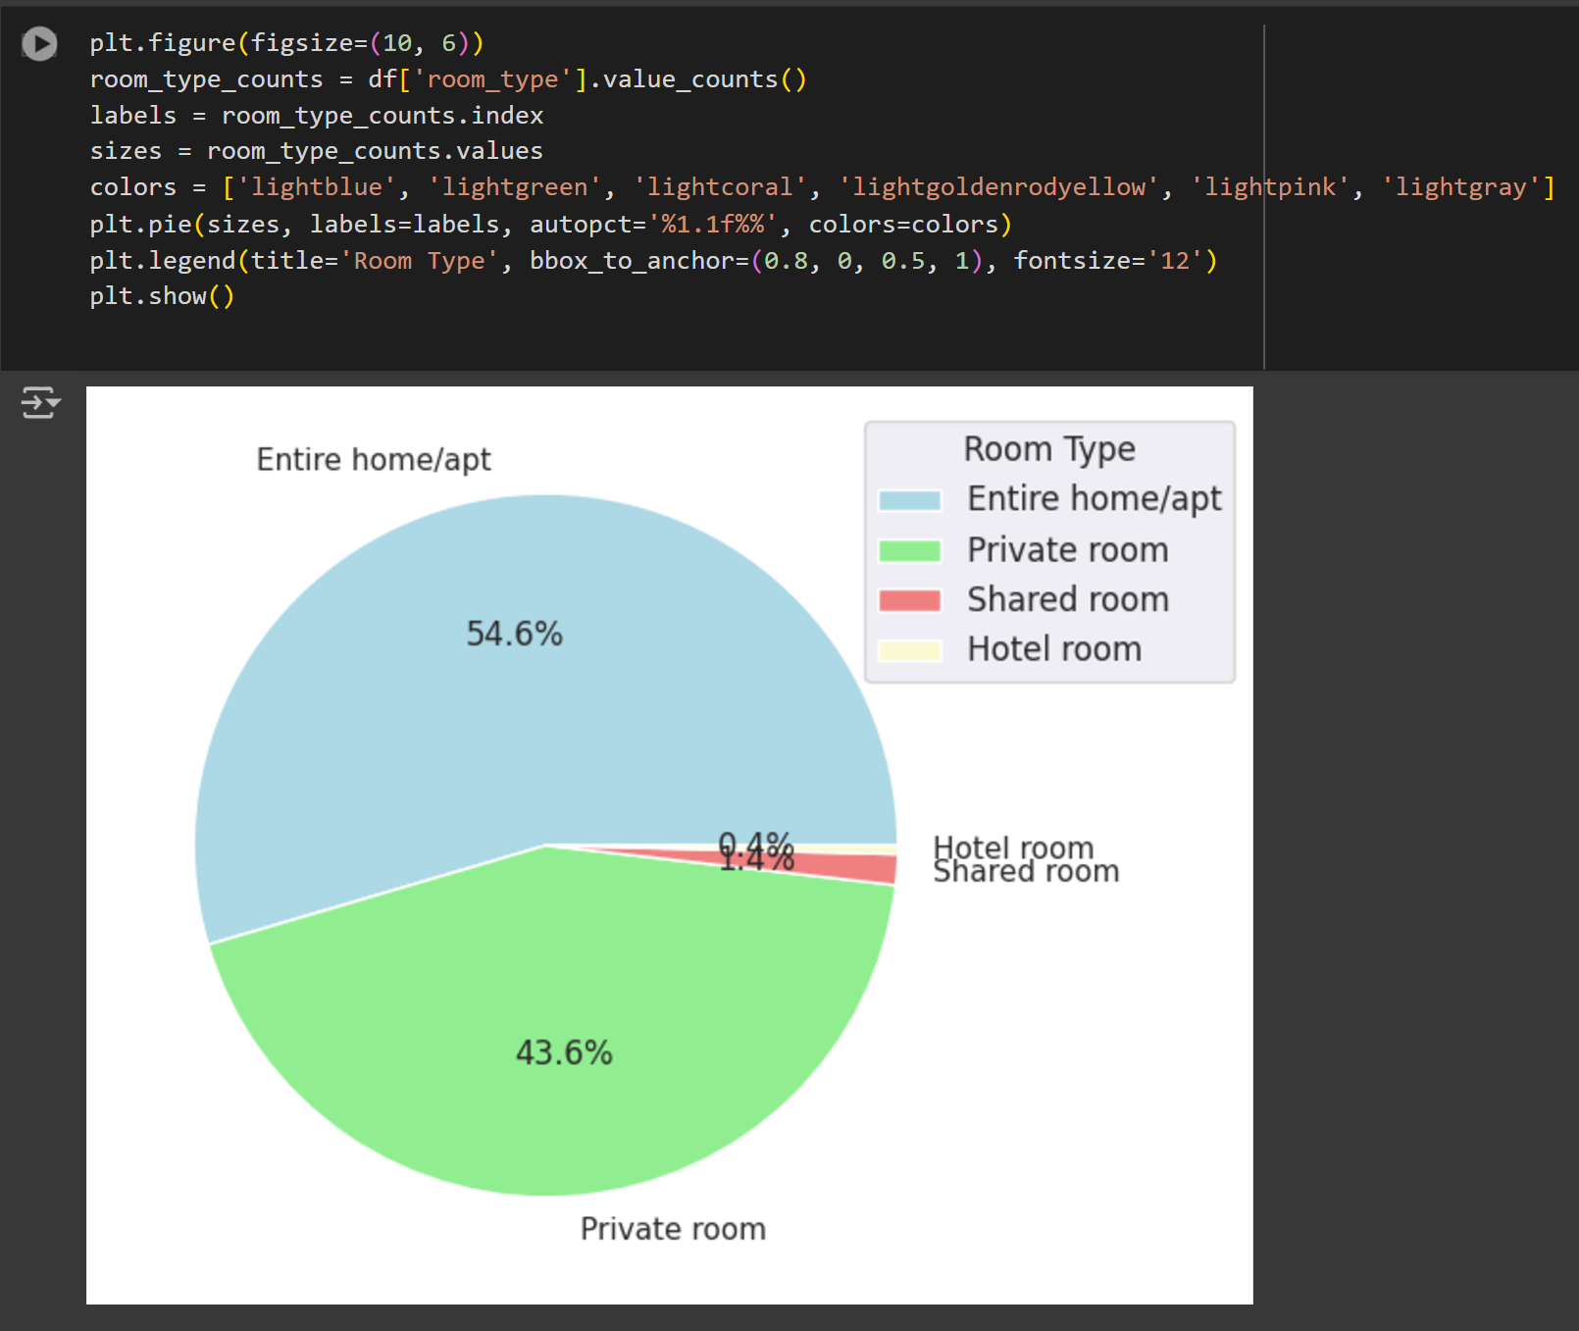

Slide 29

Stay Requirement by Minimum Nights
This analysis examines the distribution of Airbnb listings in New York City based on their minimum night stay requirements. The bar chart shows how many listings have specific minimum nights, revealing the most common stay durations.
By analyzing this data, we can identify trends in guest preferences, such as whether short-term or long-term stays are more common. This information is useful for hosts to adjust their minimum stay requirements to be more competitive and for analysts to understand the dynamics of the NYC Airbnb market.

Slide 30
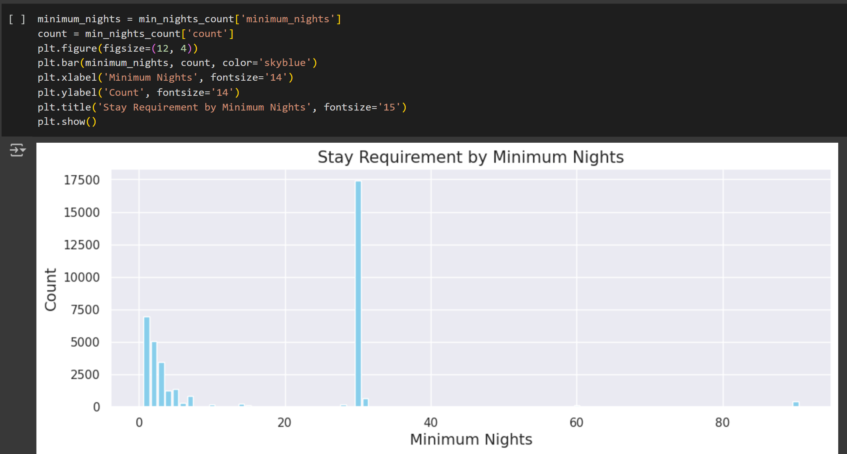

Slide 31

Number of Reviews by Neighborhood Group
Number of Reviews by Neighborhood Group in NYC This pie chart visualizes the total number of reviews for Airbnb listings across various neighborhood groups in New York City. It shows the proportion of reviews for each group, helping identify which neighborhoods are receiving the most attention from guests.
This information can be useful for hosts to understand which areas are more popular and for analysts to assess guest engagement and trends in the NYC Airbnb market.

Slide 32
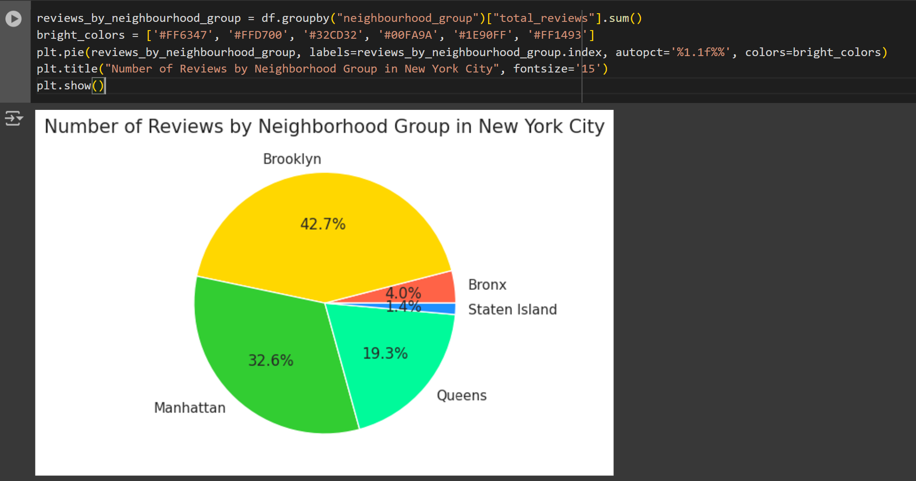

Slide 33

Most Reviewed Room Types in Each Neighborhood Group
This plot displays the number of reviews per month for various room types across different neighborhood groups in New York City. It shows which room types receive the most reviews in each neighborhood group, offering insights into guest preferences and the popularity of specific accommodations.
The analysis helps hosts understand which room types perform well in different areas, and provides analysts with a clear view of trends in guest engagement across the city.

Slide 34
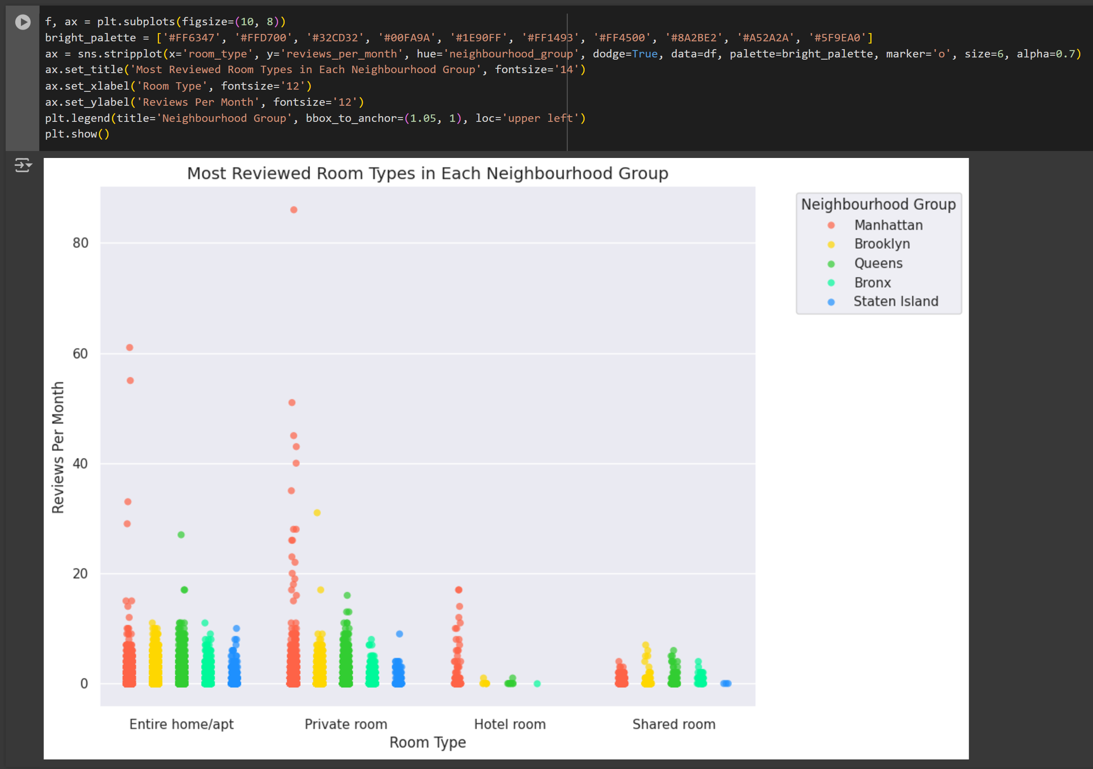

Slide 35

Count of Each Room Type in Entire NYC
This count plot displays the distribution of room types (e.g., entire homes, private rooms) across New York City, segmented by neighborhood group. It shows the total number of listings for each room type and includes percentage labels to illustrate the proportion of each type within the overall dataset.
This visualization helps to understand the prevalence of various room types in different neighborhoods, providing insights into guest preferences and regional trends in the Airbnb market.

Slide 36
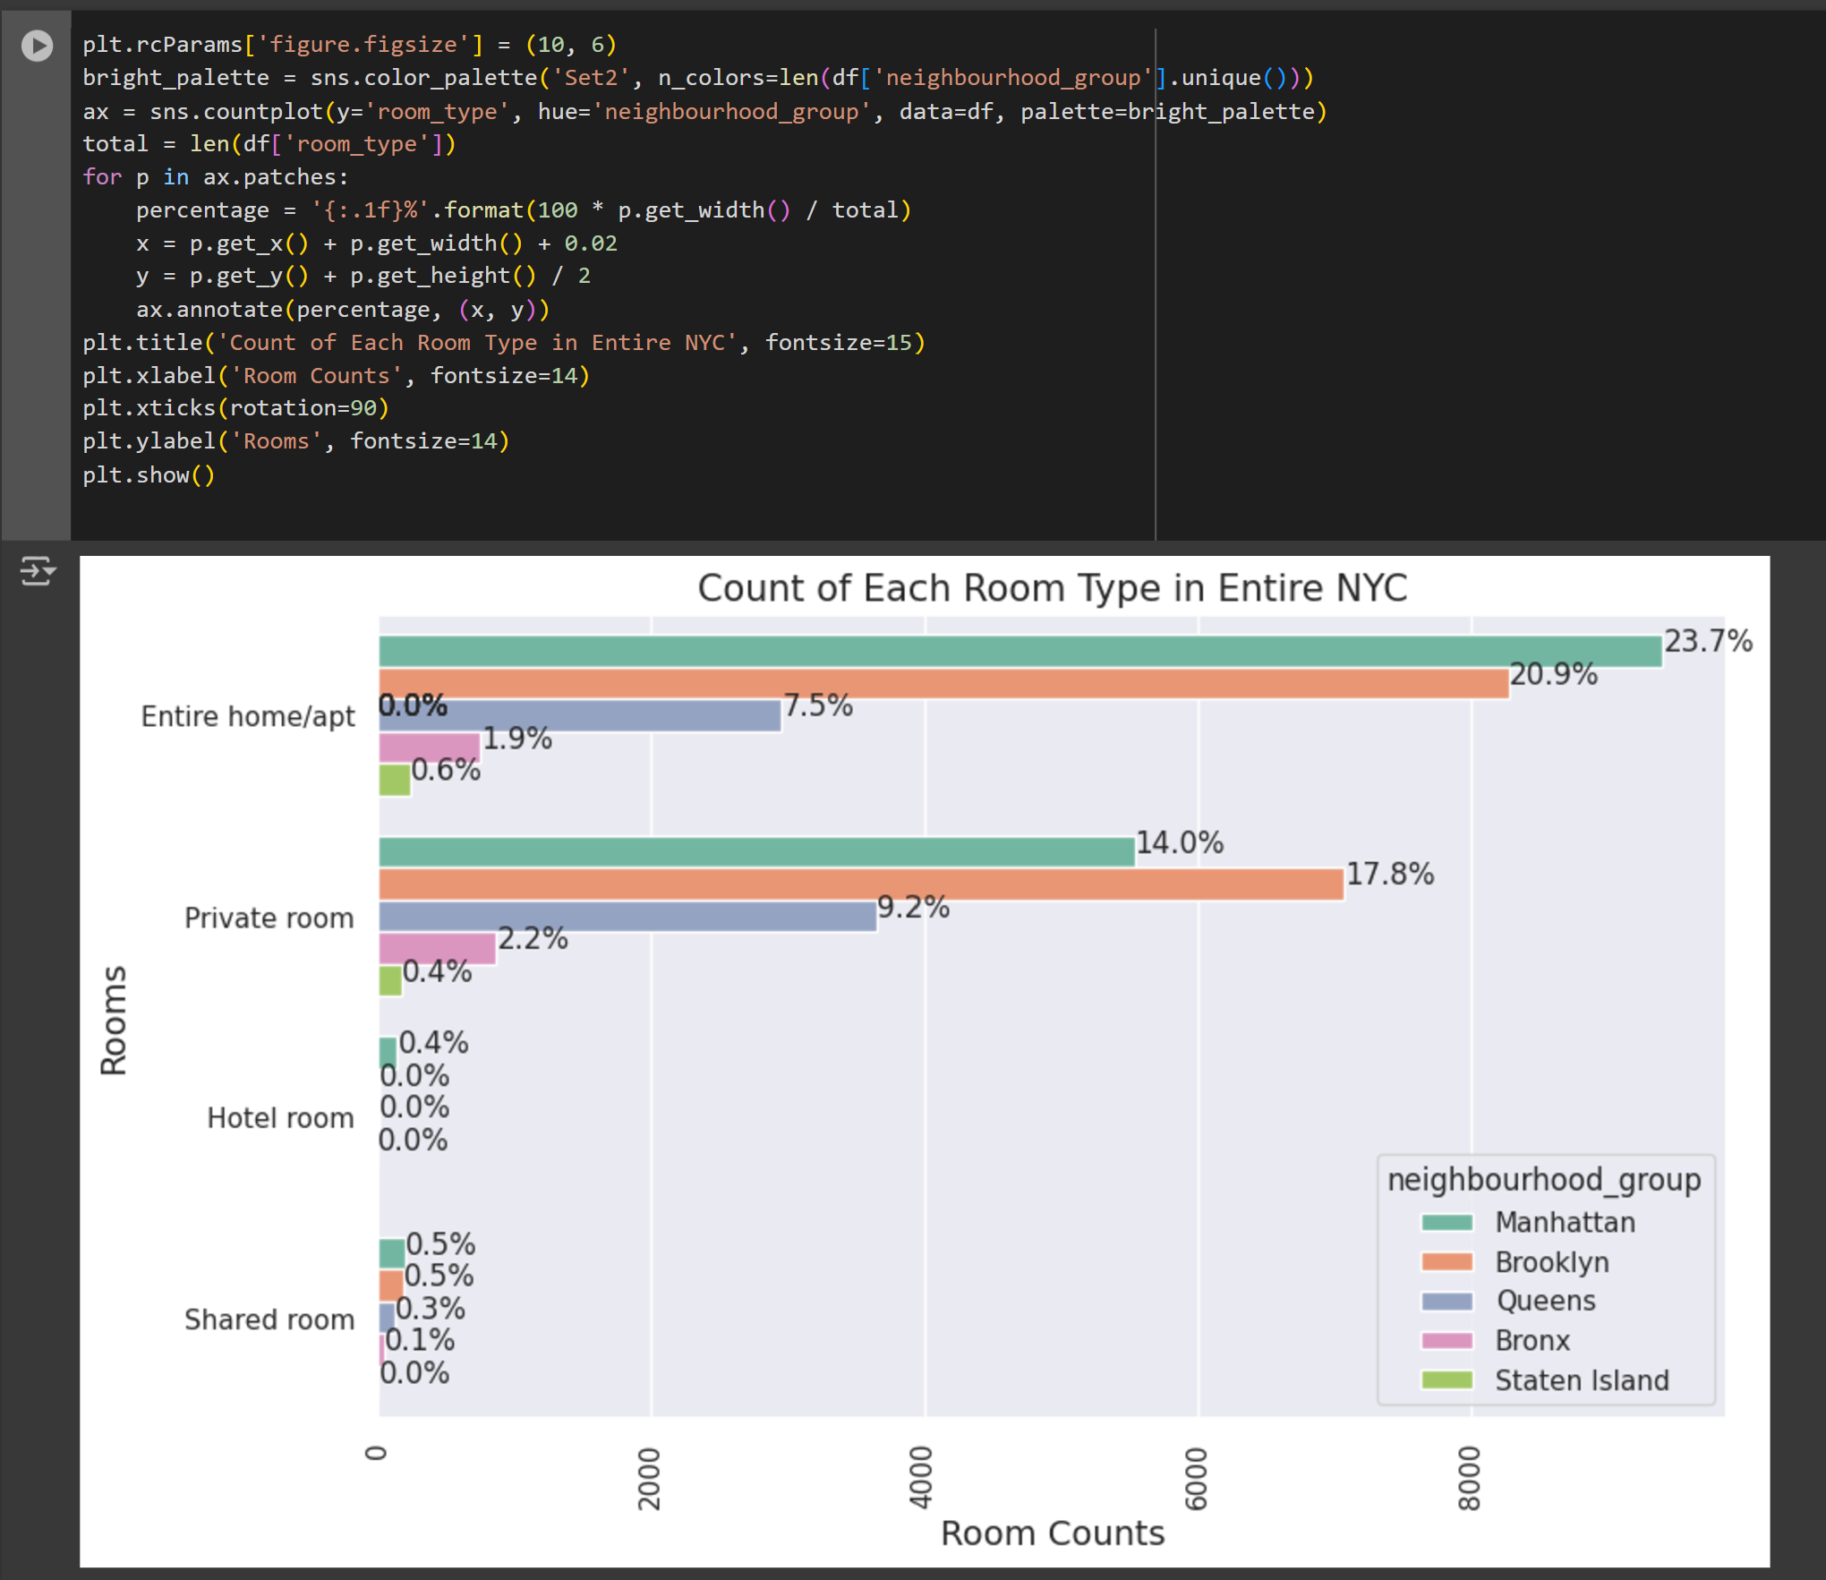

Slide 37
Location Coordinates of Airbnb Listings in NYC
This scatter plot visualizes the geographic distribution of Airbnb listings in New York City using latitude and longitude coordinates. Each point represents a listing, with colors indicating the different neighborhood groups.
The plot provides insights into where the majority of listings are located across the city, helping to identify clusters of Airbnb accommodations in different areas. By examining the plot, one can easily identify which neighborhoods have more listings and how the distribution varies geographically.

Slide 38
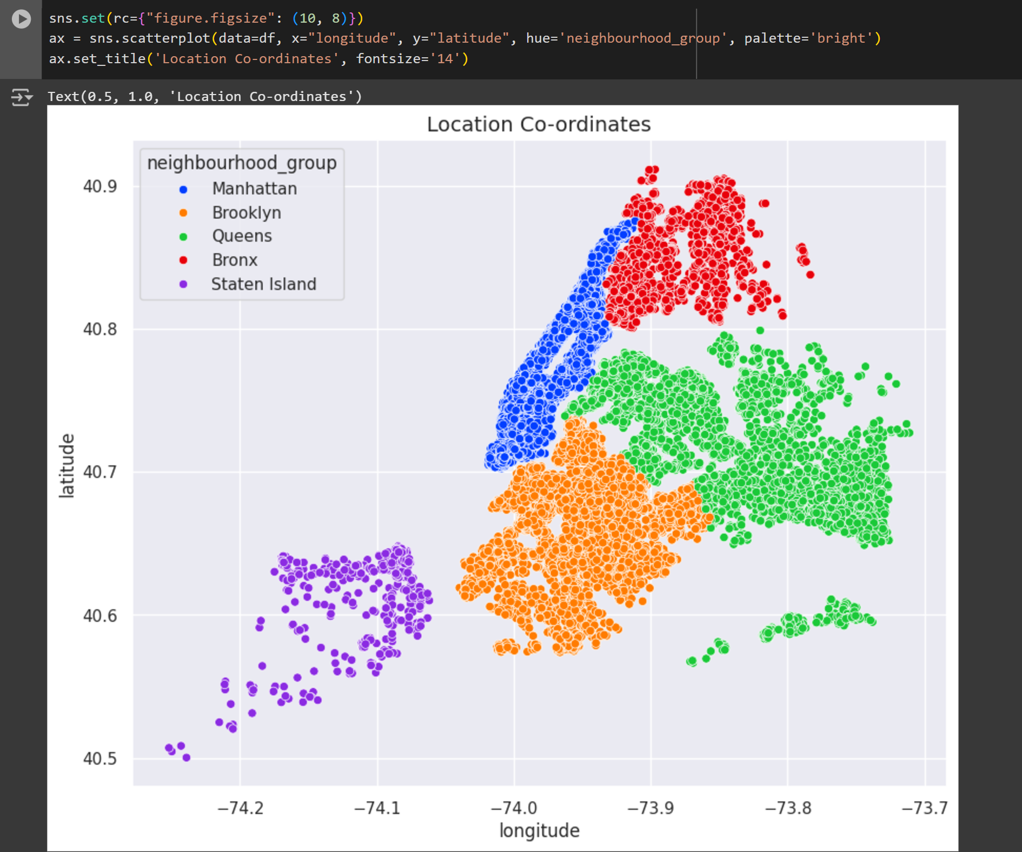

Slide 39

Distribution of Room Types Across NYC
This scatter plot visualizes the geographic distribution of different room types in New York City using latitude and longitude coordinates. Each point represents an Airbnb listing, and the color of the points corresponds to the type of room (e.g., entire home, private room).
The plot provides an overview of where each room type is concentrated within the city, highlighting patterns and trends in accommodation types across various neighborhoods. It helps to identify areas with higher concentrations of specific room types, offering insights into location-based preferences in Airbnb listings.

Slide 40
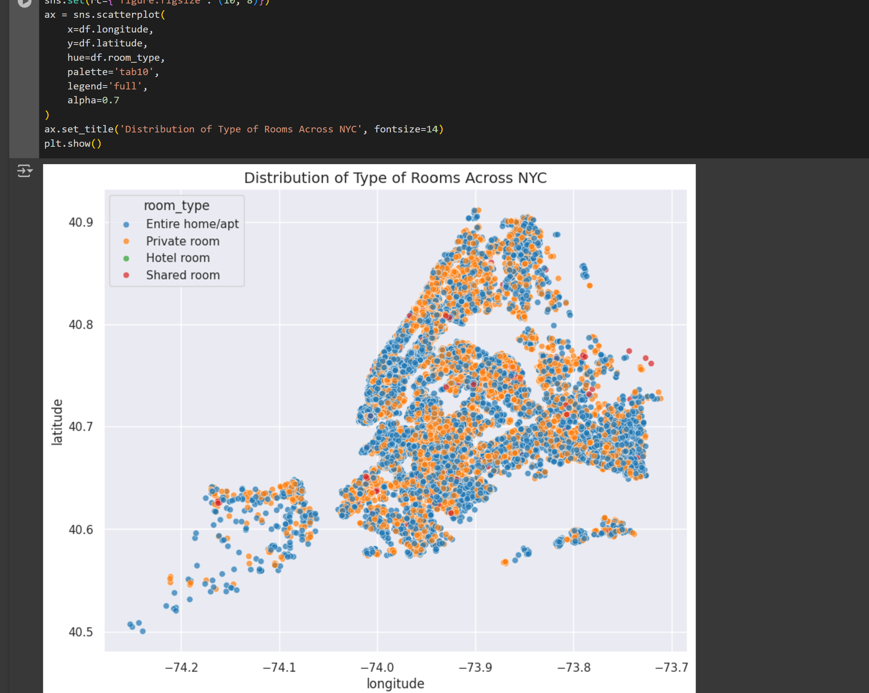

Slide 41

The Heatmap displays the correlation between the first 10 numeric columns of the Airbnb dataset
providing insights into how various features are related. It uses a color scale from cool (negative correlation) to warm (positive correlation). For example, a high positive correlation between the number of reviews and the total number of reviews might be seen, while features like latitude and longitude are likely to have little to no correlation. This visualization helps to quickly identify strong relationships between variables, which can be useful for data analysis or feature selection in modeling.

Slide 42
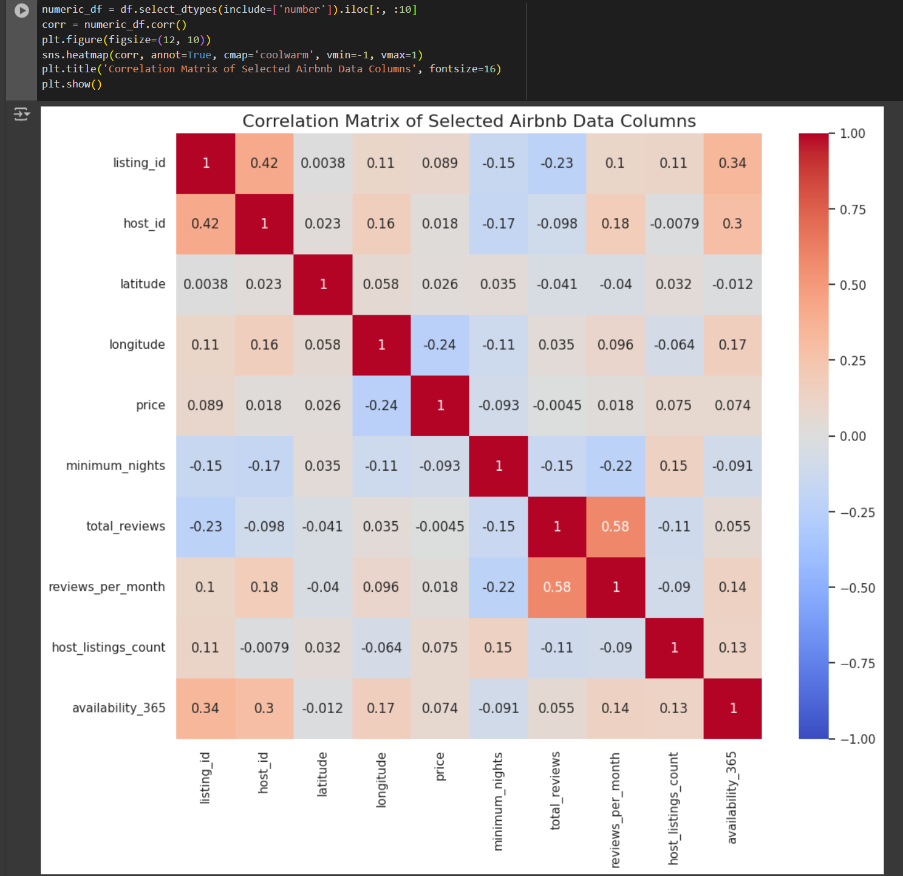

Slide 43
Linear Regression: This model is used to predict continuous outcomes, such as the price of an Airbnb listing (price). It calculates the relationship between independent variables and a dependent variable (price in this case). The model is evaluated using Mean Squared Error (MSE), which measures the average squared difference between predicted and actual values. A lower MSE indicates better performance.
Logistic Regression: This is a classification model used to predict binary outcomes, such as whether a listing is in a higher or lower price class (price_class). It estimates probabilities and assigns outcomes based on a threshold. Evaluation is done using Accuracy, which measures the percentage of correctly classified instances, and F1 Score, which balances precision and recall for a more robust assessment in imbalanced datasets.
Decision Tree Classifier: This model uses a tree-like structure to make decisions about categorical outcomes, like classifying listings based on price class. It splits the data based on feature values that provide the most information gain. Accuracy measures overall classification success, and F1 Score balances false positives and false negatives, especially useful when data is imbalanced.Random
Forest Classifier: This is an ensemble method that builds multiple decision trees and combines their predictions. It provides a more robust classification by averaging over many trees. Like the Decision Tree, it is evaluated using Accuracy and F1 Score, but it often provides better results due to reduced overfitting.
Machine Learning techniques

Slide 44
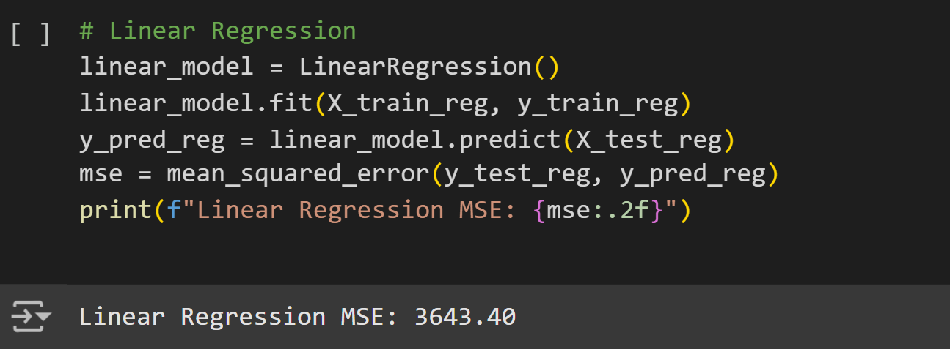
Linear Regression: This model is used to predict continuous outcomes, such as the price of an Airbnb listing (price). It calculates the relationship between independent variables and a dependent variable (price in this case). The model is evaluated using Mean Squared Error (MSE), which measures the average squared difference between predicted and actual values. A lower MSE indicates better performance.

Slide 45
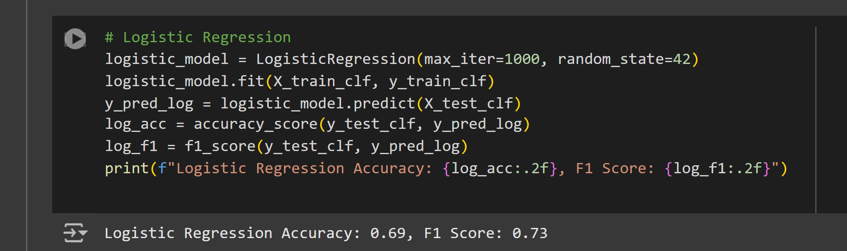
Logistic Regression: This is a classification model used to predict binary outcomes, such as whether a listing is in a higher or lower price class (price_class). It estimates probabilities and assigns outcomes based on a threshold. Evaluation is done using Accuracy, which measures the percentage of correctly classified instances, and F1 Score, which balances precision and recall for a more robust assessment in imbalanced datasets.

Slide 46
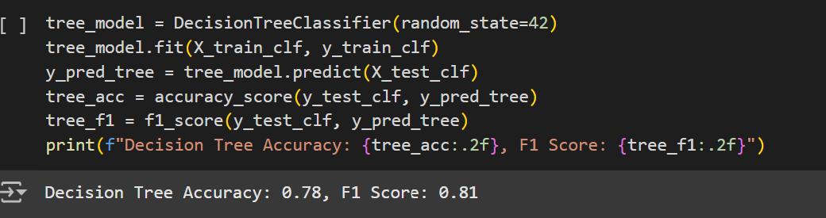
Decision Tree Classifier: This model uses a tree-like structure to make decisions about categorical outcomes, like classifying listings based on price class. It splits the data based on feature values that provide the most information gain. Accuracy measures overall classification success, and F1 Score balances false positives and false negatives, especially useful when data is imbalanced.Random

Slide 47
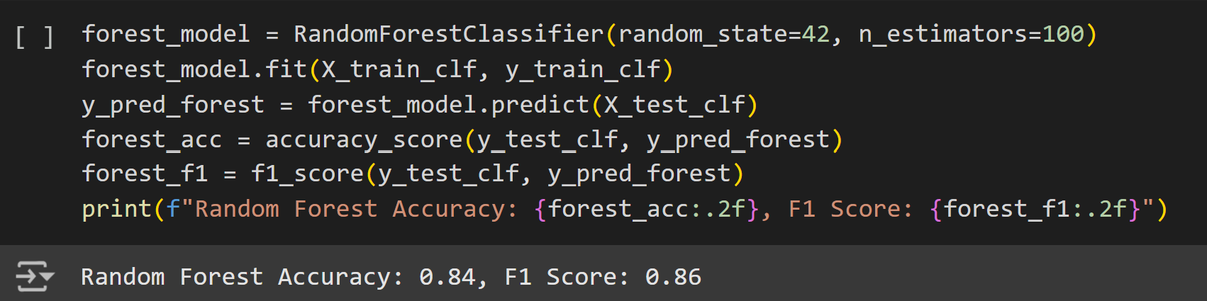
Forest Classifier: This is an ensemble method that builds multiple decision trees and combines their predictions. It provides a more robust classification by averaging over many trees. Like the Decision Tree, it is evaluated using Accuracy and F1 Score, but it often provides better results due to reduced overfitting.

Slide 48
10 most important features decision tree
This code visualizes the top 10 most important features used by a decision tree model. It first extracts the feature importances, sorts them in descending order, and selects the top 10 features. A bar chart is then created to display these features, with their importance values shown on the y-axis. The chart helps to identify which features have the greatest impact on the decision tree's predictions, making it easier to understand the model's behavior. The x-axis shows the feature names, and the bars are colored in 'skyblue' for better visibility.

Slide 49
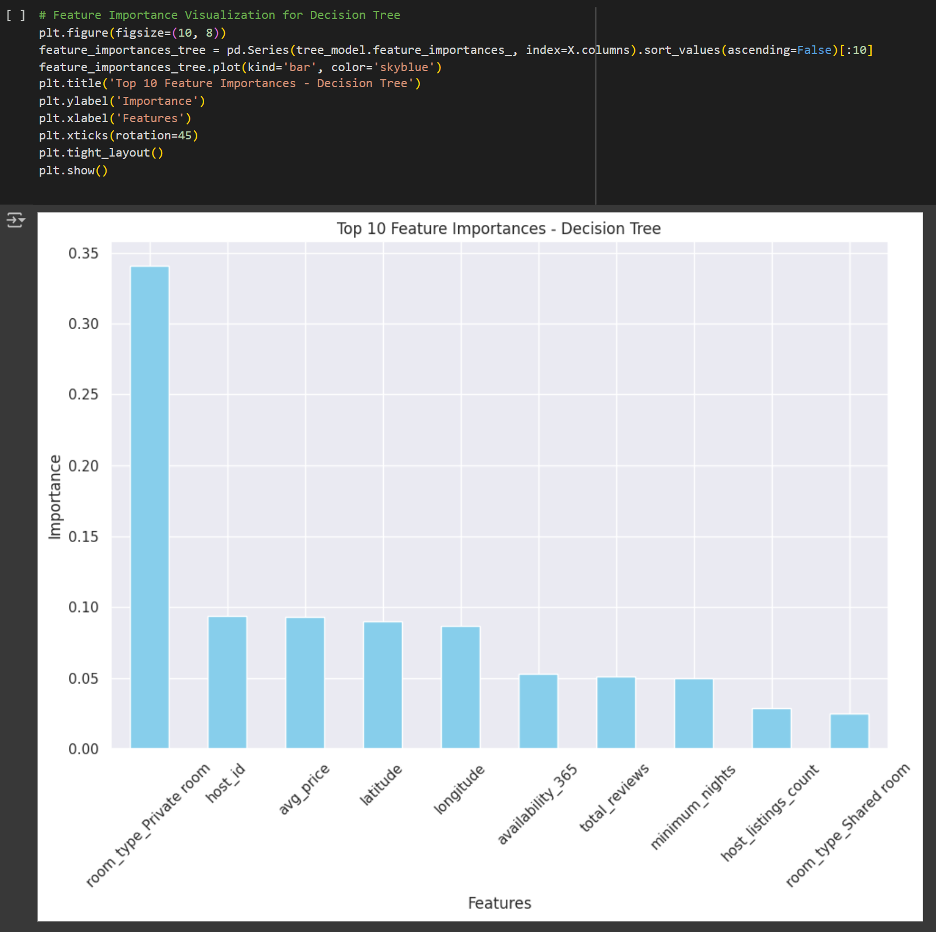

Slide 50
10 most imporatant fetaures by random forest
This code visualizes the top 10 most important features used by a Random Forest model. It begins by extracting the feature importances from the model and sorting them in descending order. The top 10 features are selected, and a bar chart is created with the features on the x-axis and their corresponding importance values on the y-axis. The chart uses a green color to highlight the importance of each feature. The title and axis labels help in understanding the context, while the rotation of the x-axis labels makes the feature names easier to read. This visualization aids in interpreting which features contribute most to the Random Forest model's decisions.

Slide 51
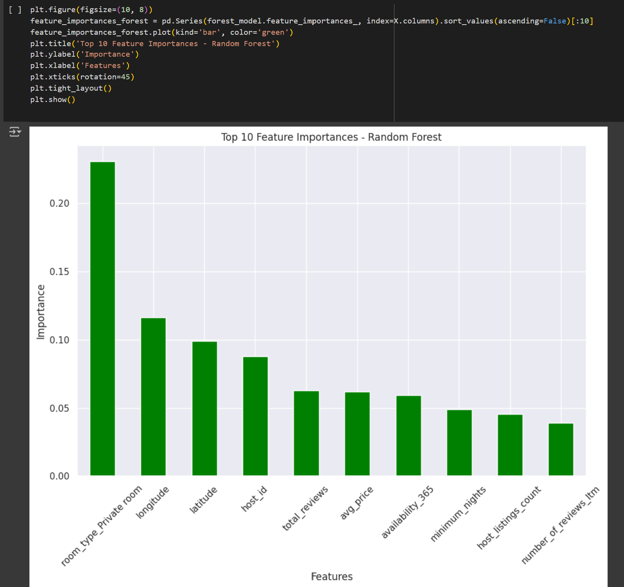

Slide 52
Model Suitability Models:
Random Forest Classifier: High accuracy (84%) and F1 score (0.86), robust against overfitting, ideal for dynamic pricing and predictions with complex datasets.
Decision Tree Classifier: Good accuracy (78%) and F1 score (0.81), interpretable and effective for exploratory analysis but prone to overfitting.
Least Suitable Models:
Linear Regression: Struggles with non-linear relationships, high MSE, better as a baseline model.
Logistic Regression: Moderate performance (59% accuracy, 0.75 F1 score), not ideal for complex datasets due to linear assumptions.Conclusion: Random Forest and Decision Trees are most suitable for handling non-linear, complex data in this analysis.

Slide 53

References
Edelman, B., & Geradin, D. (2015). Efficiencies and regulatory problems of the sharing economy: The case of Airbnb.
Manipulation in Online Reviews: A Case Study of Airbnb’s Review System. Harvard Business School Working Paper.Guttentag, D. (2015). Airbnb: Disruptive innovation and the rise of an informal tourism accommodation sector.
The Sharing Economy: The End of Employment and the Rise of Crowd-Based Capitalism. MIT Press.Wachsmuth, D., & Weisler, J. (2018). The impact of Airbnb on housing affordability: Evidence from New York City.

Slide 54

Conclusion
Airbnb has significantly disrupted the traditional hospitality and tourism industries, providing affordable, unique accommodation options that cater to diverse consumer preferences. While it has created economic opportunities for homeowners and boosted local economies, it has also led to challenges such as rising housing costs in certain cities. The platform’s reliance on user reviews and ratings has been key to building trust and fostering its growth, but it also raises concerns around fairness and inequality.Regulation remains a critical issue as cities work to balance the benefits of Airbnb with the need for oversight.
Future research will need to explore the long-term impact of Airbnb on housing markets, the environment, and the broader economy, as well as the effectiveness of emerging regulatory measures. Overall, Airbnb continues to shape the future of travel and accommodation, but its growth requires ongoing attention to its social, economic, and regulatory implications.

